Slide 1

Scaled Agile and Critical Path
June 3, 2020
Rick Cottle
Notes:
Title Slide. Update the Project Name and the Month. The month is the past months period of performance that is being covered.

Slide 2
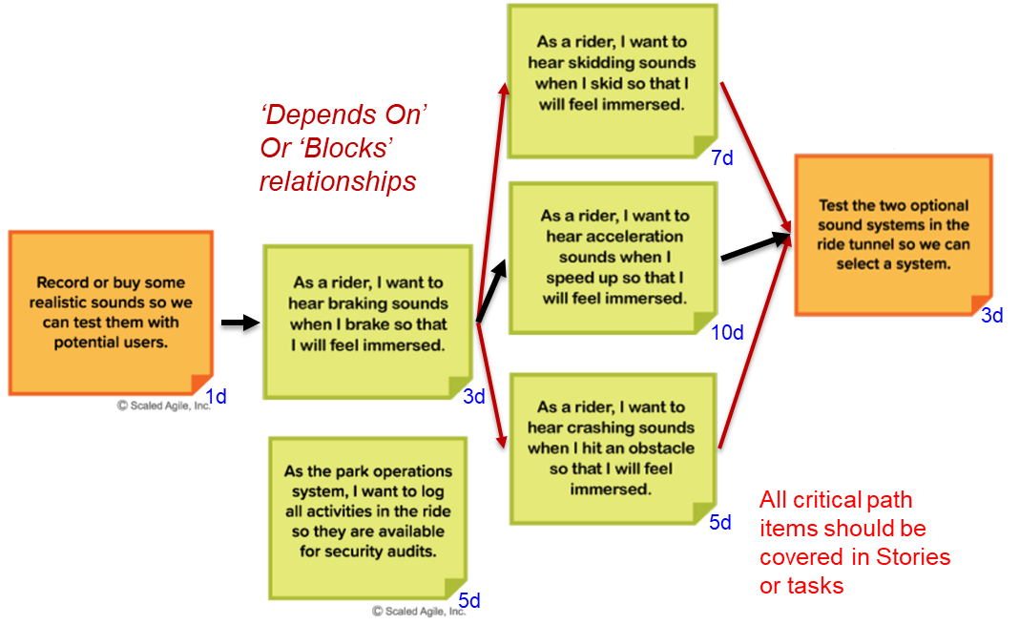
Critical Path Requirement for Feature Owners
The role of Feature Owner (FO) was rolled out for PI 14. One of the responsibilities for the FO is to create a Critical Path (CP) for the feature, and attach it to the feature’s work item by the end of Sprint 1.
From the Training (page 11):
Critical Path is the minimum amount of time needed for the feature to complete
It identifies the stories/tasks that make up that minimum time
All critical path items should be covered in Stories or tasks
Set dependencies in RTC, but Critical Path must be tracked outside of RTC as RTC doesn’t track Critical Path. (MS Project, Excel, Word,…)

Slide 3
Critical Path Requirement for Feature Owners
From the Training (page 12), Best Practices:
List all the milestones required to complete feature
“Critical” milestones have deadlines directly impacting feature timeline (i.e. if it slips, the final delivery, demo, etc. is at risk of slipping).
Check that your critical path makes logical sense
List dates and sprint #s
Many milestones are mid-sprint.
Understand the schedule slack in your critical path
The flexibility/margin within your critical path
Risks should be identified for critical path items
Critical path progress should be discussed with team and stakeholders often
Typically Critical Path is not necessary for LOE Features
Attach the Critical Path document as an attachment to the Feature. Include ‘Critical Path’ in the file name as the Audit checks for this.
This retrospective was based on the idea that…
If the dependency relationships between stories are in RTC, along with…
the duration (story points), should allow us …
to automate the generation of Critical Path charts for all features.
The benefits of this would be:
Less burden on the Feature Owners,
a consistent format for all Critical Path Documents, and possibly
a tool that could be used at the Epic level to show CP across Features.

Slide 4
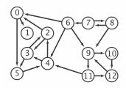
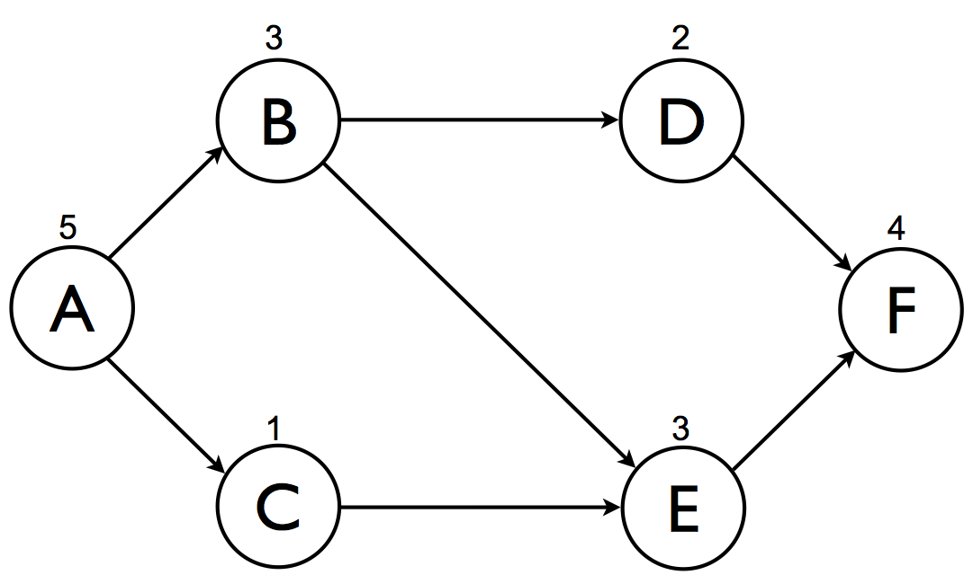
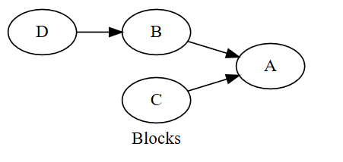
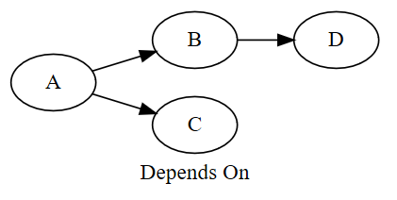
Use of a Directed Graph
Digraphs.
A directed graph (or digraph) is a set of vertices and a collection of directed edges that each connects an ordered pair of vertices. https://algs4.cs.princeton.edu/42digraph/
Critical Path.
A critical path is determined by identifying the longest stretch of dependent activities and measuring the time required to complete them from start to finish. https://en.wikipedia.org/wiki/Critical_path_method
RTC Dependency
Links

Slide 5





Automated RTC Critical Path Generation
The criticalpath.py Python script:
Parses the input Excel spreadsheets to get the feature and story data, including the blocks links
For each feature:
creates a .dot directed graph file
Invokes dot.exe to generate a .png bitmap file
CustomerReport.xlsx
Team – xxxxxxx.dot
criticalpath.py
Team – xxxxxxx.png
PI_XX_Feature_Ranked_List.xlsx
dot.exe

Slide 6
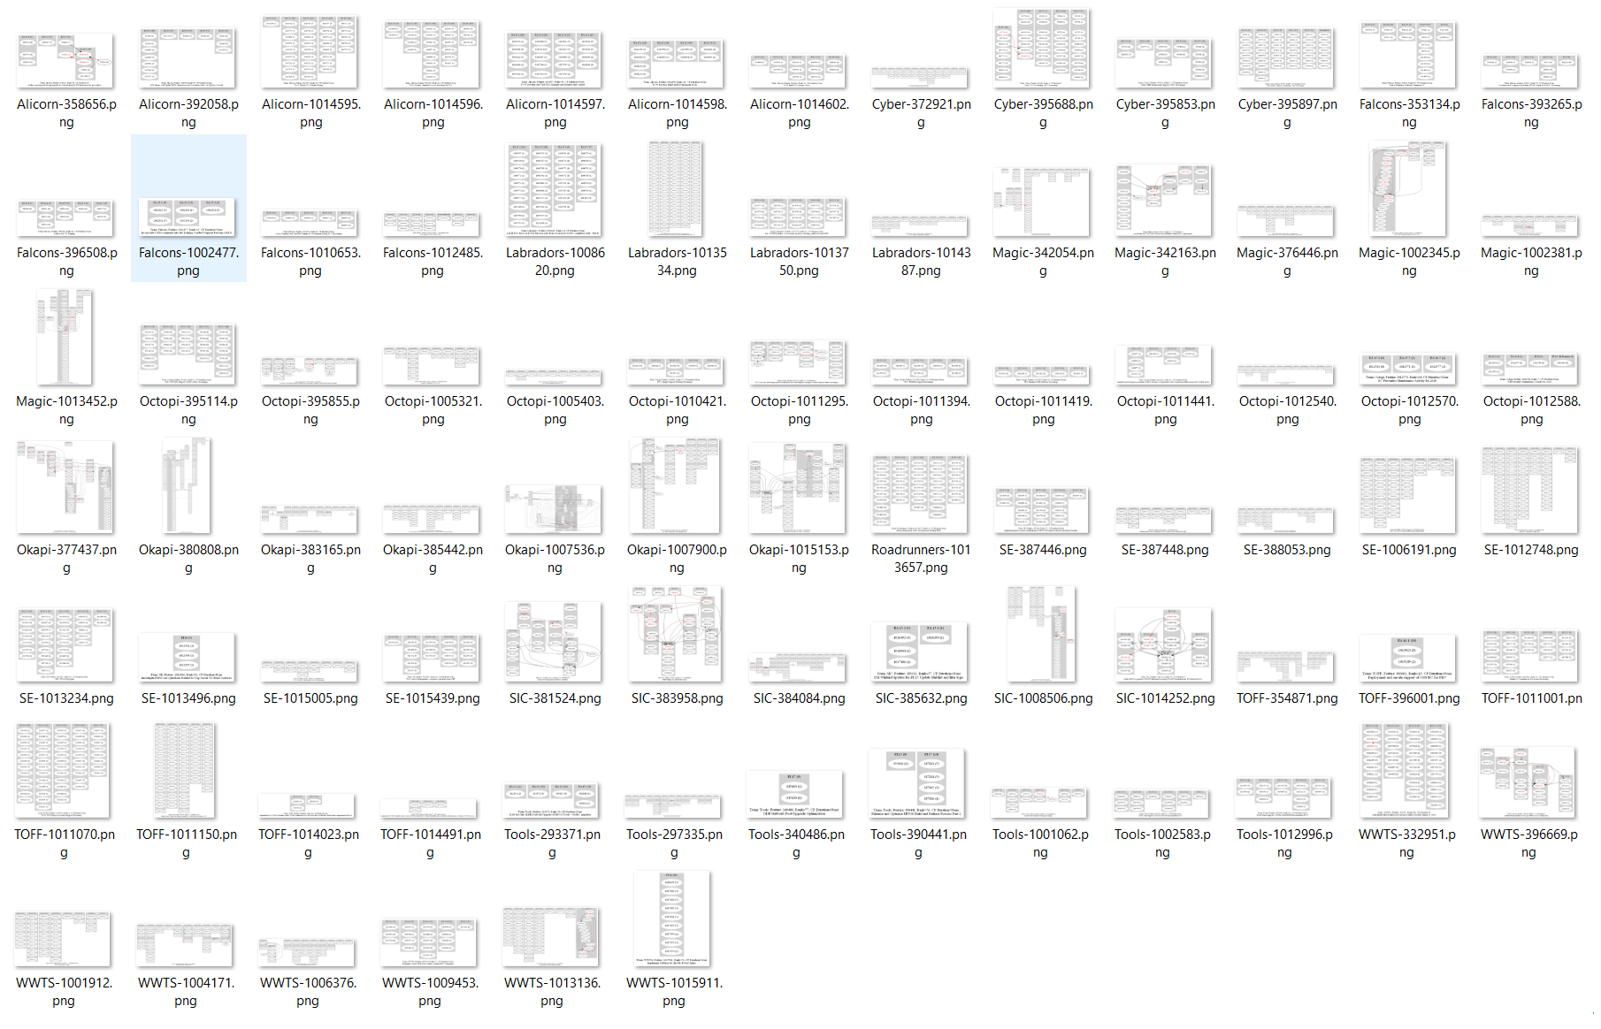
Gallery of PI 15 Features

Slide 7
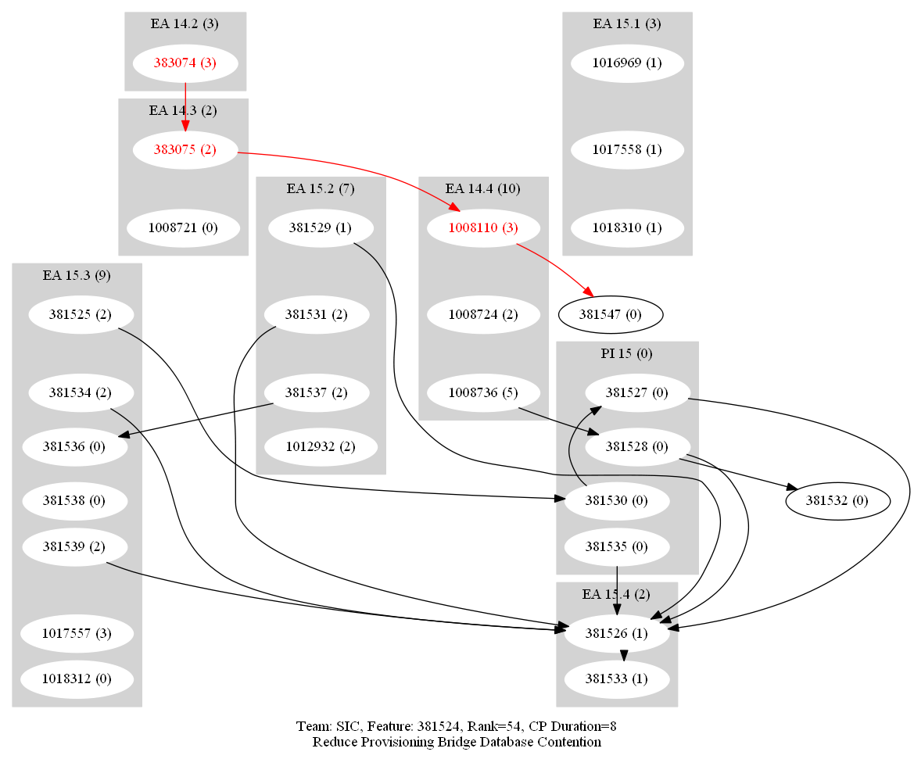
Case Study 1 – Simple dependencies
Sprint (total story pts)
Story (story pts)
Non-critical dependencies
Critical Path dependencies
The algorithm picks the path with the greatest total Story Points

Slide 8
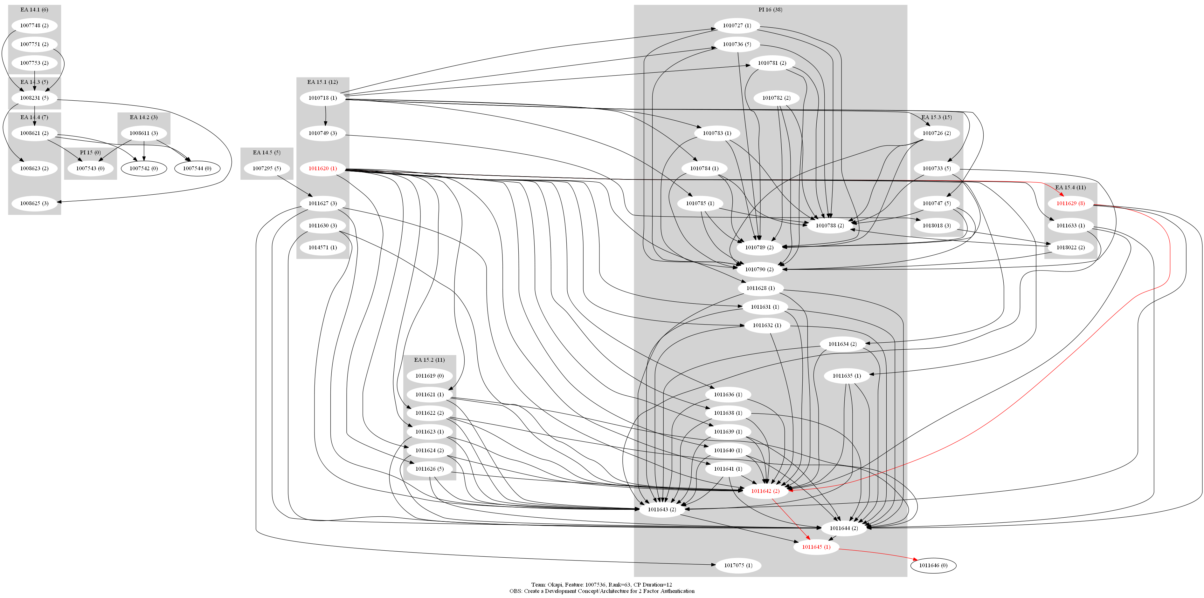
Case Study 2 – Complex dependencies
The critical path does not add any real value in managing the feature
For example, choosing stories to pause to allow swarming on stories that are in trouble

Slide 9
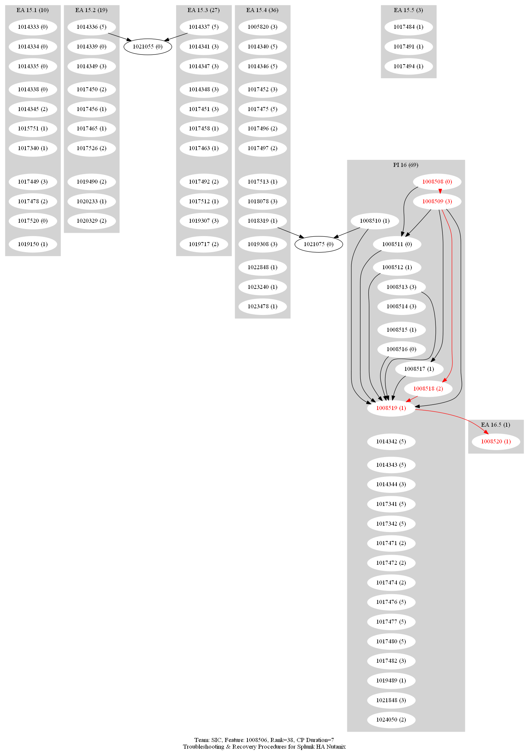
Case Study 3 – non-typical feature SIC 1008586
This feature started in PI 14 (PI 15 In Progress)
Effort consists of writing approximately 18 procedures (approximately as follows)
Developers write 18 procedures
Developers dry-runs (3 x 6 procedures)
Interim demo (9 procedures)
Final demo (9 procedures)
Many procedures requires multiple stories (part 1, part 2, etc.)
There are also many supporting stories, such as UX, MFR, ILS, PDO
The Feature Owner developed dependencies for the early stories but struggled with determining dependencies for entire feature (especially In-Progress stories).
The Scrum Master offered to help.

Slide 10
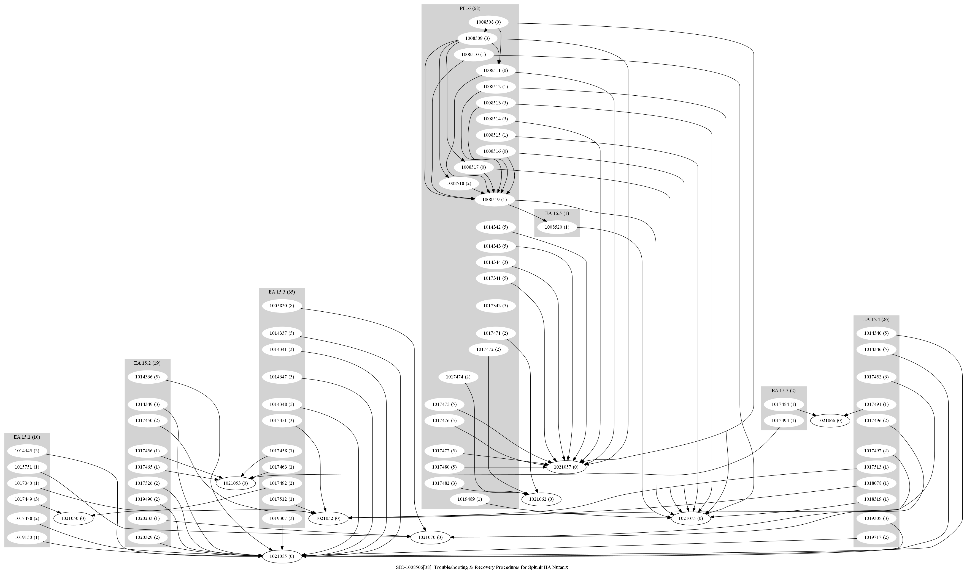
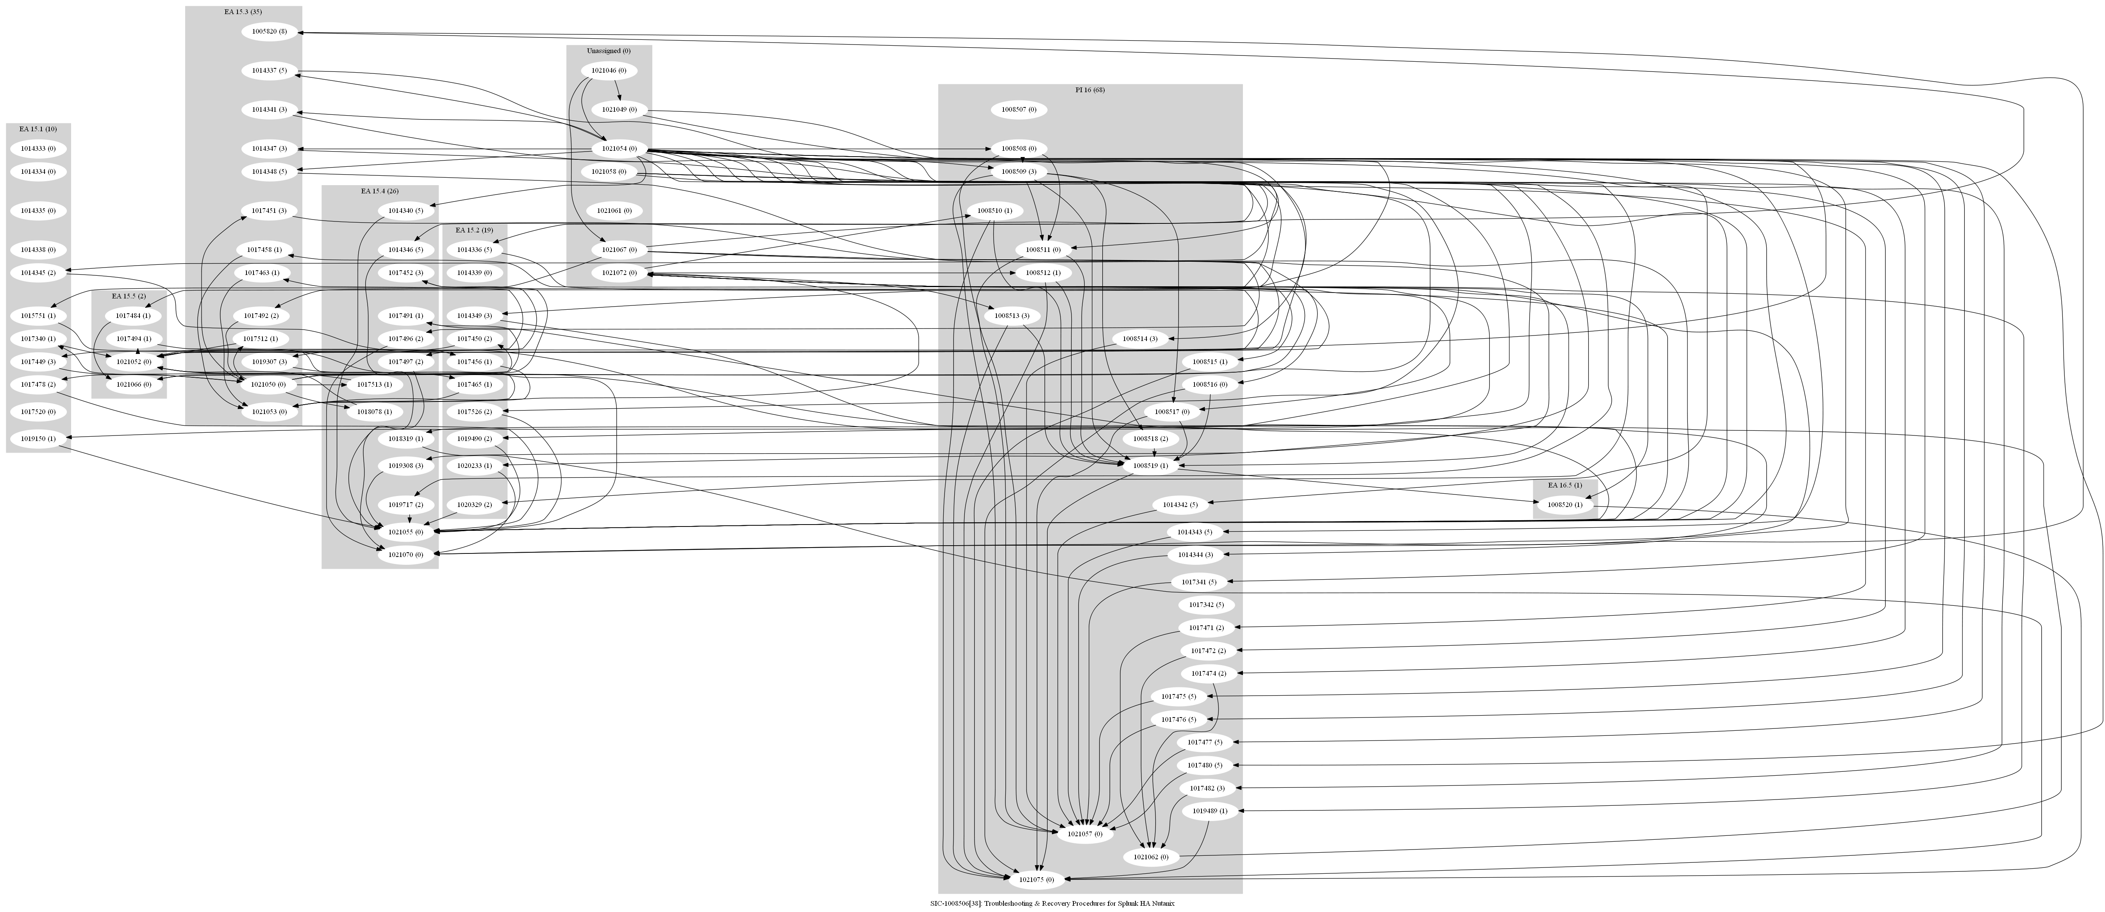
Case Study 3 – non-typical feature SIC 1008586
Steps taken to develop Critical Path for 1008586
Add dependency links directly between stories
This quickly became onerous, especially for multipart stories and was thus abandoned
Create “milestone” tasks to allow grouping of tasks, e.g. 6 author stories feeding 1 dry-run story
This was even worse since it required many additional links to be created
New tasks were artificial, making it more difficult to keep things straight
Also abandoned as it was obvious the approach was too burdensome for the FO
Use MS Project to identify the critical path, with the intent to only put those dependency links in RTC
Since Project is designed to manage dependencies and calculate critical paths, perhaps it is the best tool for this task.
original
Step 2.
Step 1.

Slide 11
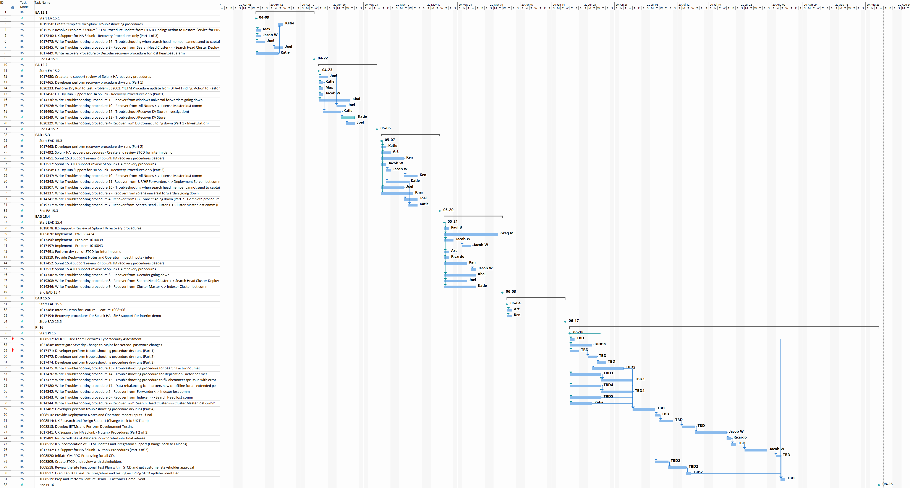
Case Study 3 – non-typical feature SIC 1008586
Microsoft Project Attempt 1

Slide 12
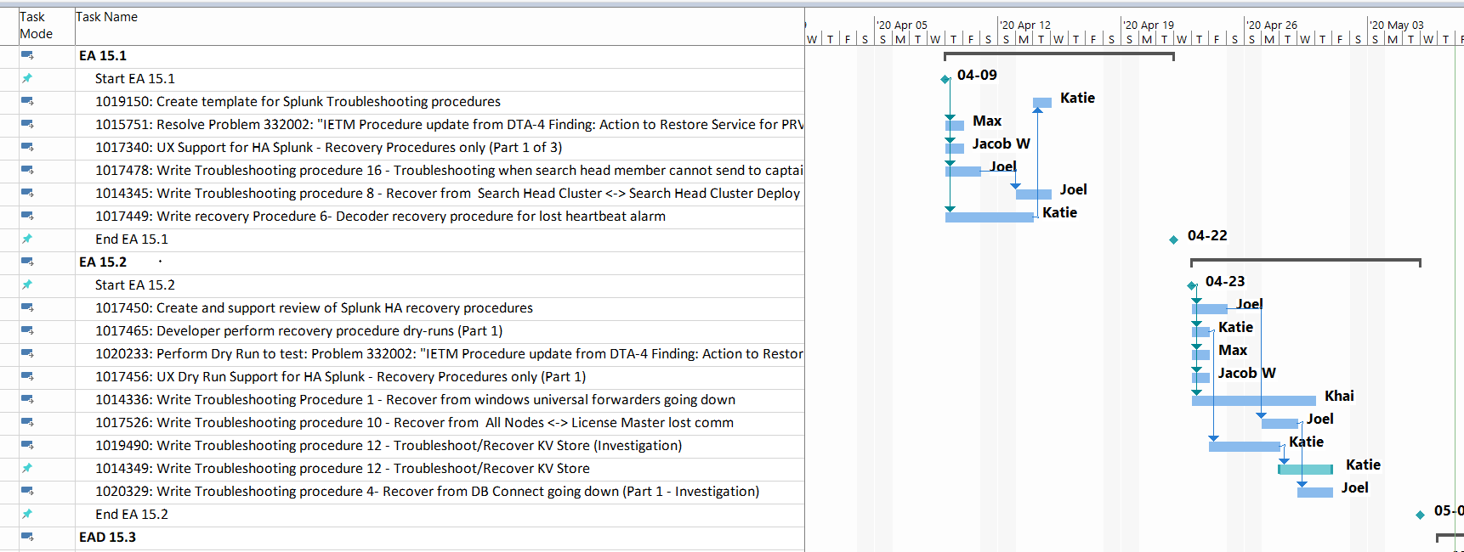
Case Study 3 – non-typical feature SIC 1008586
Microsoft Project Attempt 1
Resource assignments made by team during PI and Sprint Planning
Dependencies between stories based on resource availability
Dependencies between Sprints not indicated; Sprint boundaries produce slack—no real critical path for Feature.

Slide 13
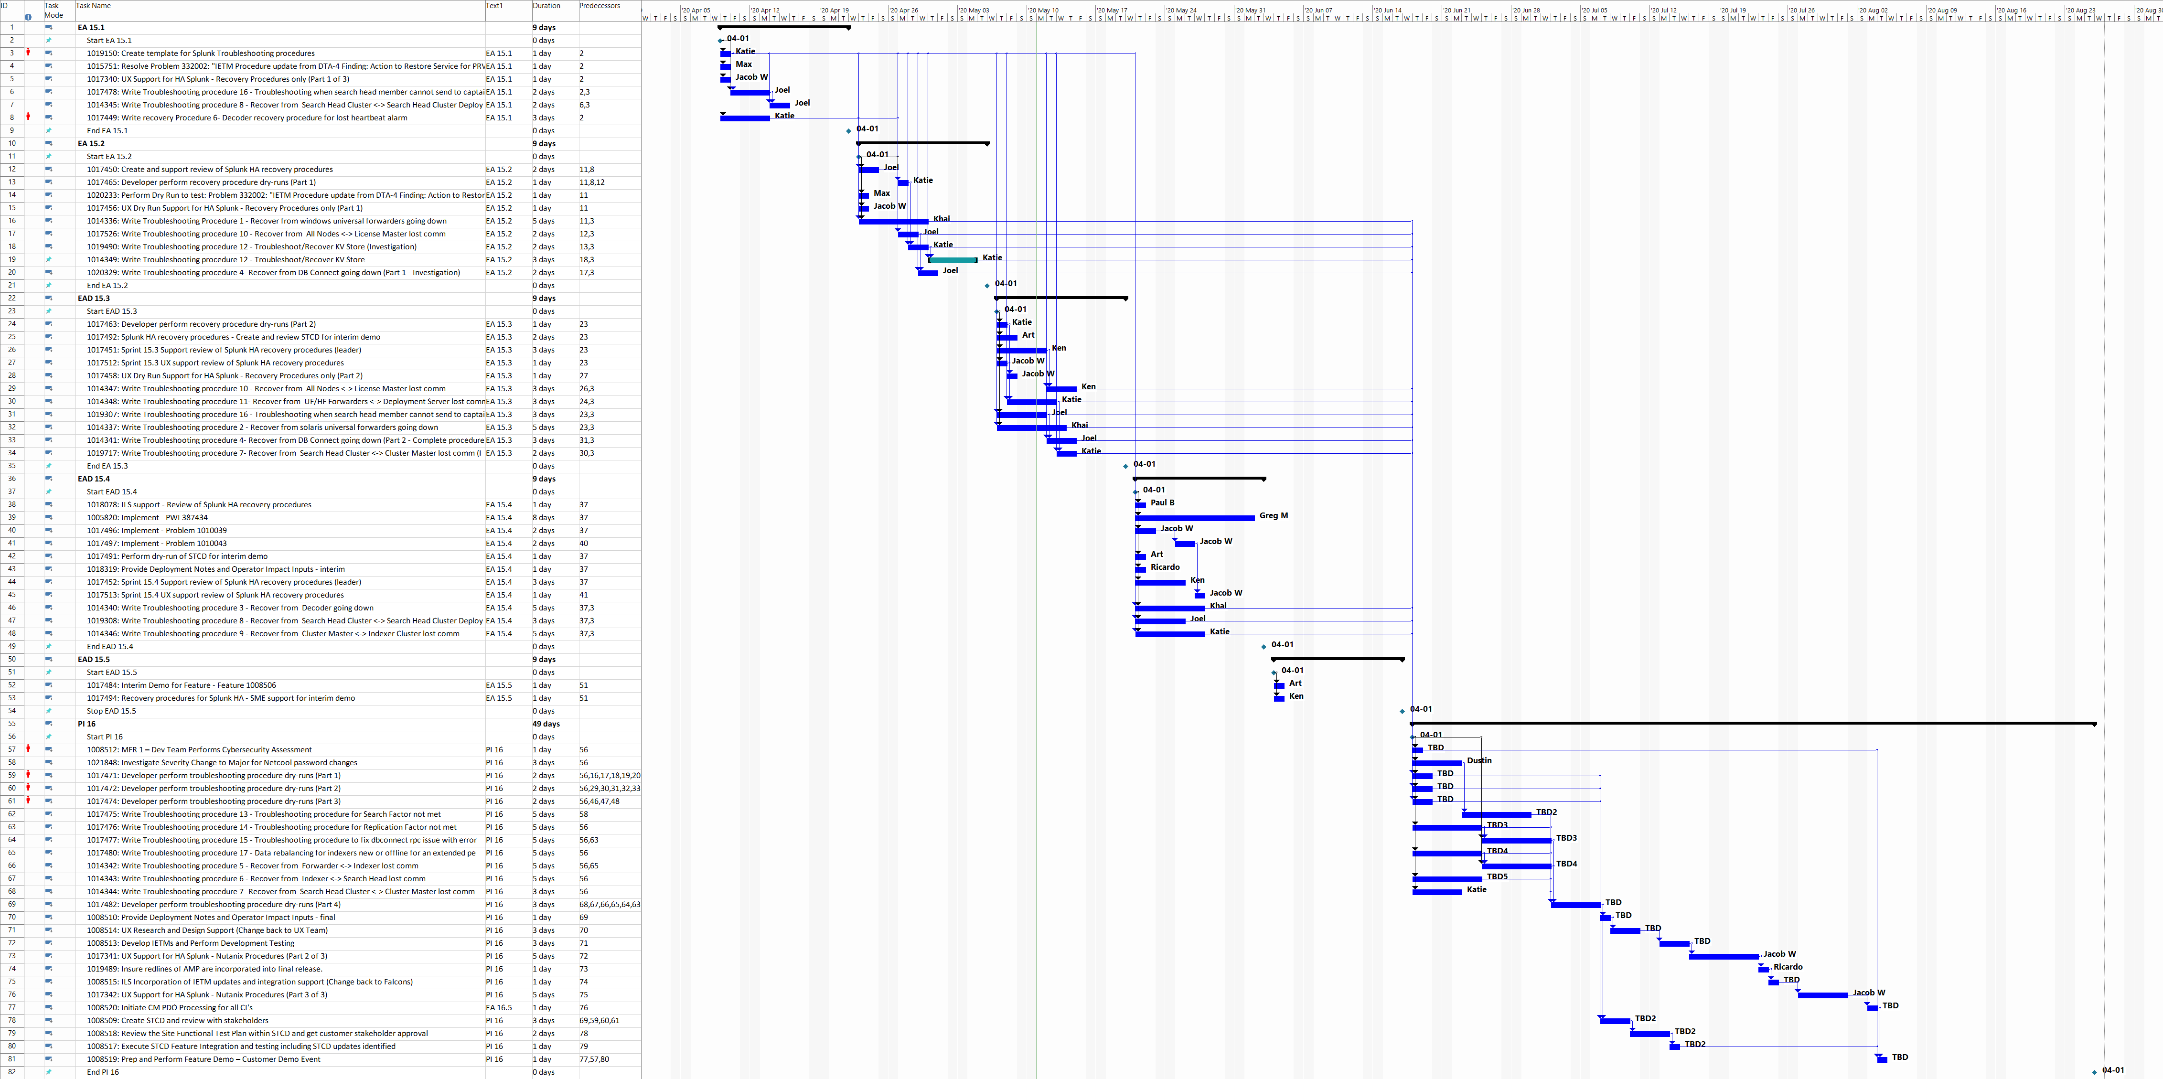
Case Study 3 – non-typical feature SIC 1008586
Microsoft Project Attempt 2

Slide 14
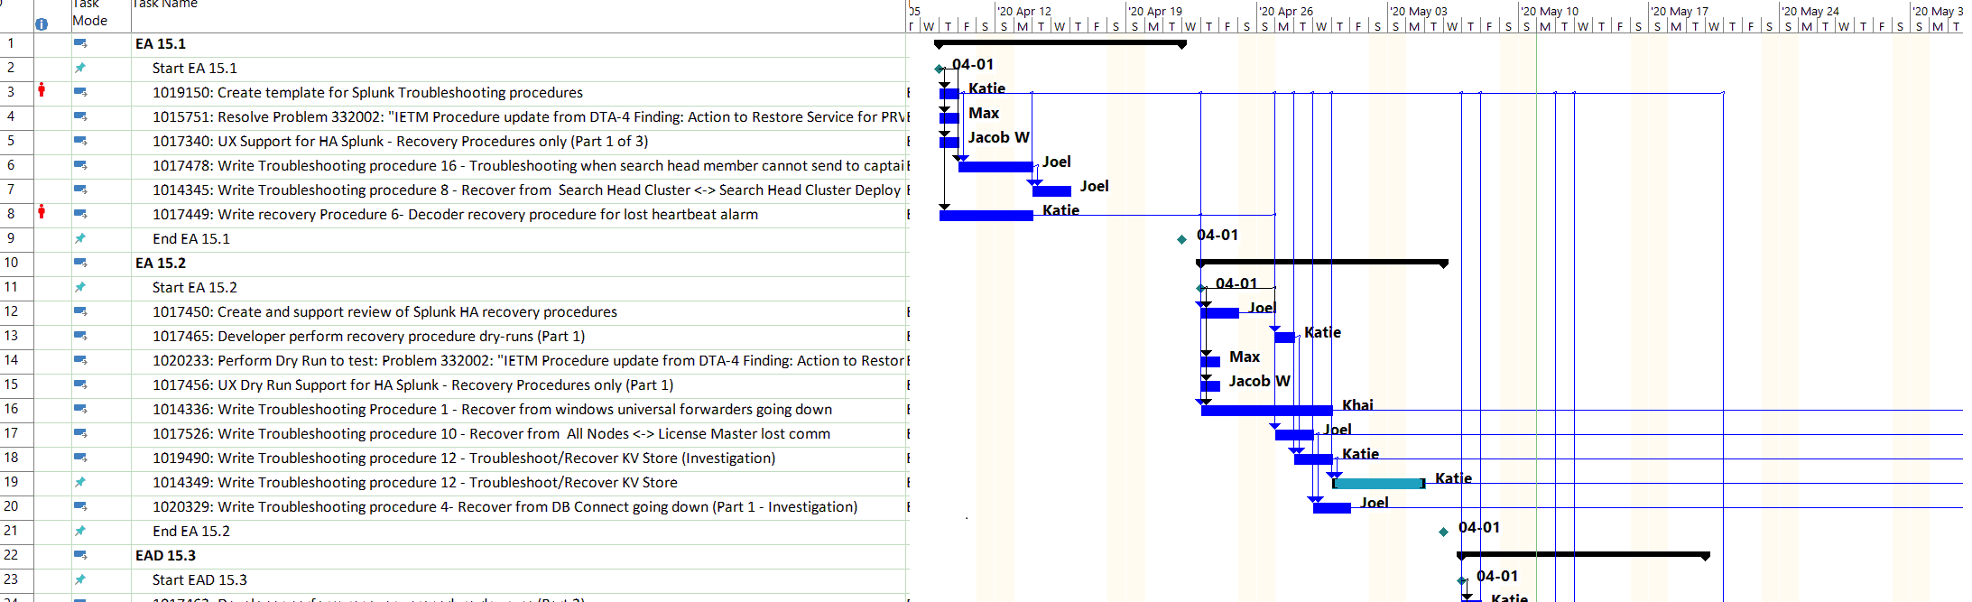
Case Study 3 – non-typical feature SIC 1008586
Microsoft Project Attempt 2
Logical dependencies added between stories crossing Sprint Boundaries
Forcing fixed start times for each Sprint prevents Project from calculating critical path

Slide 15
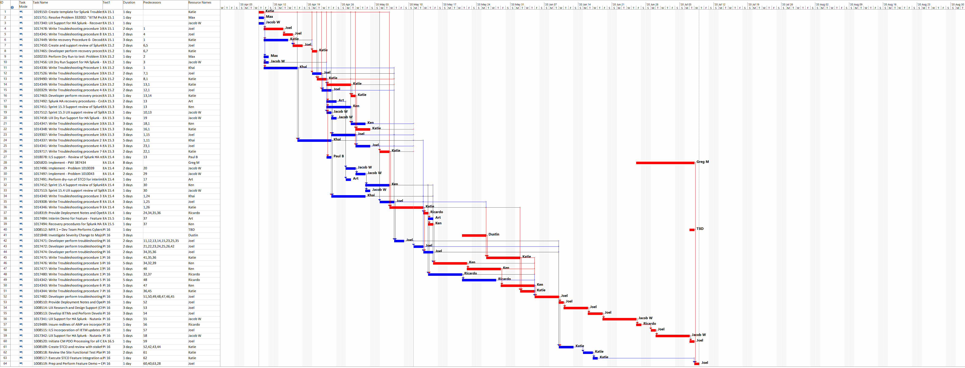
Case Study 3 – non-typical feature SIC 1008586
Microsoft Project Attempt 3

Slide 16
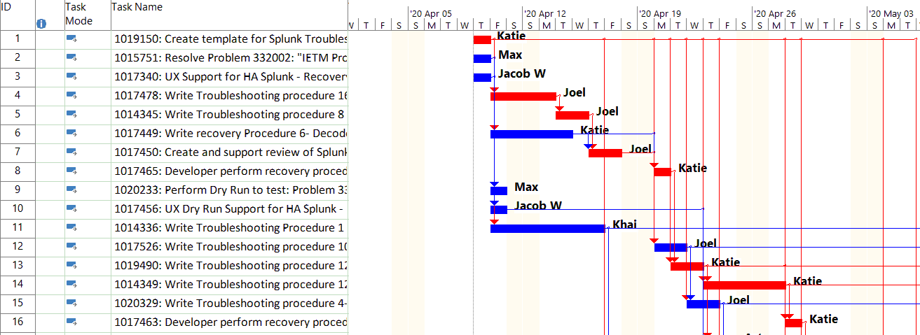
Case Study 3 – non-typical feature SIC 1008586
Microsoft Project Attempt 3
Removed all artificial constraints of Sprints
MS Project now calculates the critical path based on the dependencies (resource availability.
Since the order the procedures are written, and who can write them, is arbitrary, the critical path does not help manage the features. In real life the FO and team adjusts and replans as needed during the sprint.

Slide 17
Conclusion: Defining Critical Path for Features
Using automated tools to create critical path documents
This effort started out to try and help over worked Feature Owners by creating a tool that generates the document for them
The MUOS Program would benefit by having all Features documented the same way.
What was learned is that the hard part is analyzing which Stories make up the Critical Path.
Many MUOS Features do lend themselves well for Critical Path Analysis.
Sprints create natural slack that by definition take all the stories off the critical path
In general a Story slipping won’t cause the Feature to slip.
Naturally, things like demos in the last Sprint can cause the Feature to slip, but everyone already knows that.
Agile is has benefits but it does not produce the fastest schedule
The schedule with no sprints actually finishes the Feature one month sooner than as planned for PI 15 In Progress, because the white space in the Sprints is eliminated.
A web search only yielded reasons not to use Critical Path in the context of Agile.
It might make sense at the Epic Level between Features, but not at the Feature level between Stories/Sprints.
“[The Critical Path] does need to be considered by the team but this can be very informal and usually without even using words like "critical path." It happens naturally during a team's iteration planning meetings and daily standups when they ask themselves questions about how they're going to finish the planned work.”¹
¹https://www.mountaingoatsoftware.com/blog/the-critical-path-on-agile-projects

Slide 18
Backup and Appendix Sections
The following Backup pages show the calculated Critical Path based on the dependency links of each Feature as of EA 15.4. They are provided for reference and amusement only.
The last page of the presentation contains the source code used for generating the graphs.

Slide 19
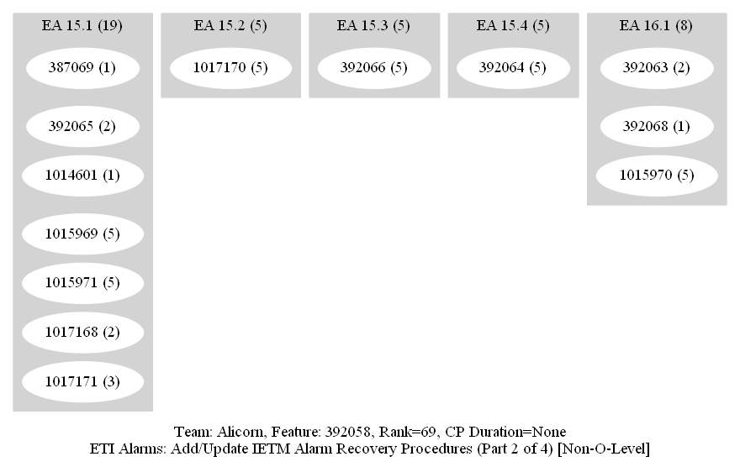
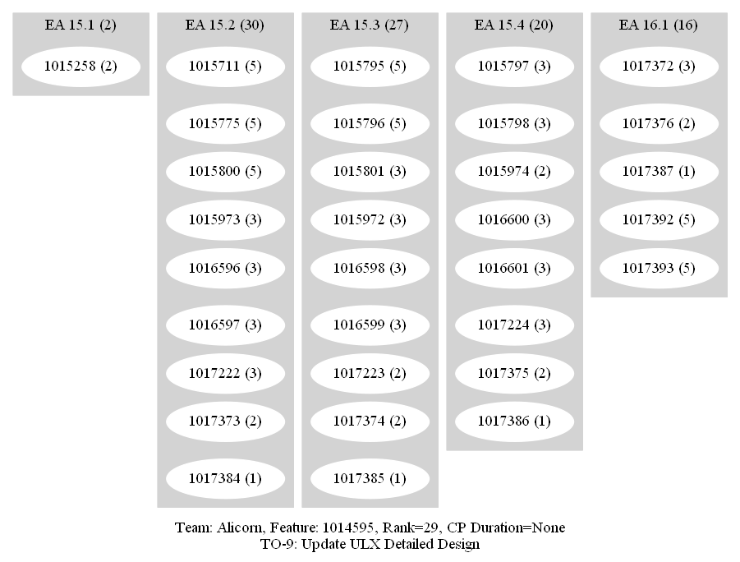
BACKUP
Auto-generated Dependency Graphs for PI 15 Features - Alicorn

Slide 20
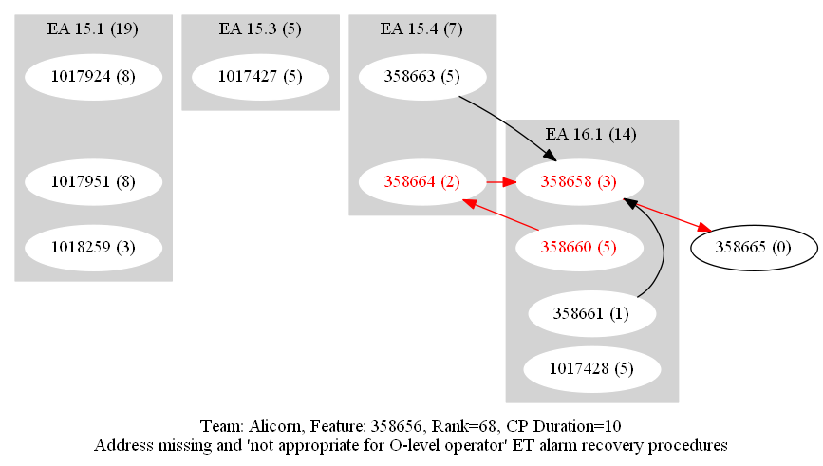
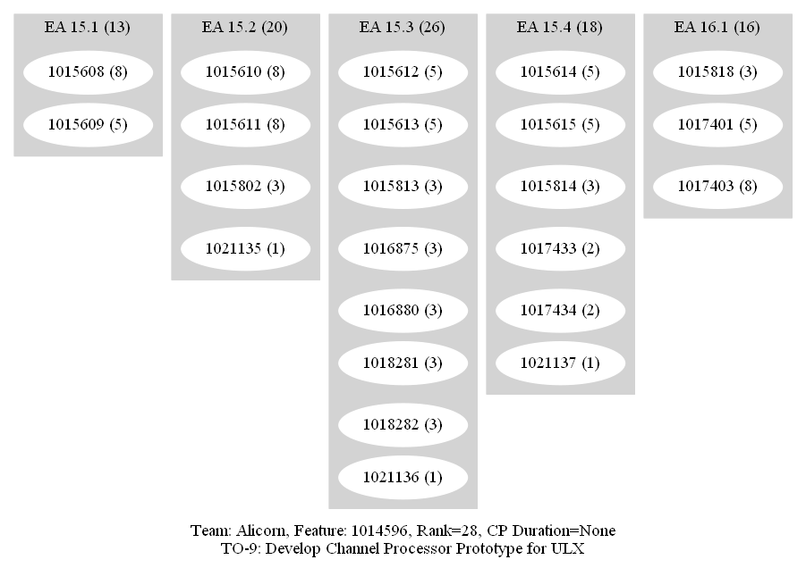
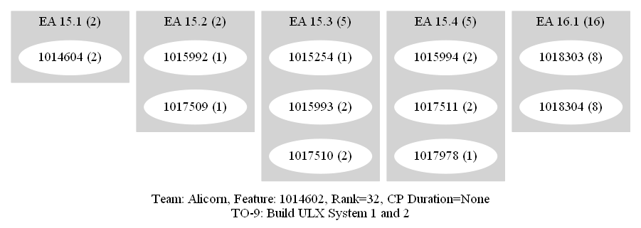
BACKUP
Auto-generated Dependency Graphs for PI 15 Features - Alicorn

Slide 21
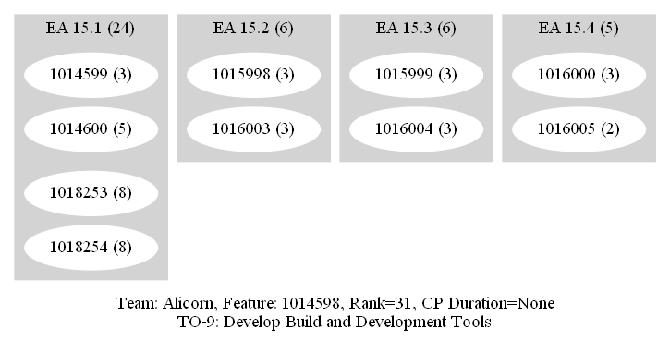
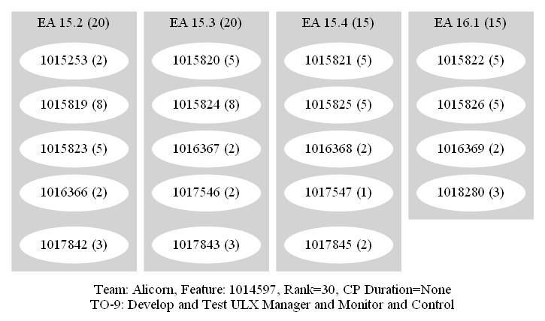
BACKUP
Auto-generated Dependency Graphs for PI 15 Features - Alicorn

Slide 22
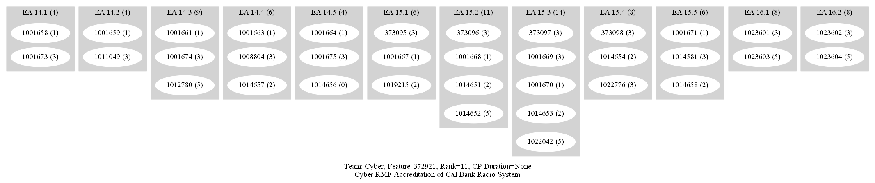
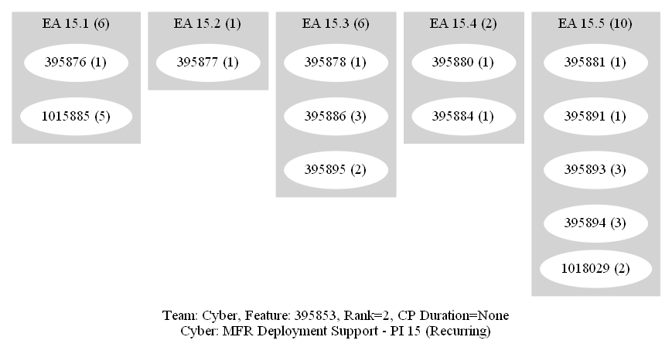
BACKUP
Auto-generated Dependency Graphs for PI 15 Features - Cyber

Slide 23
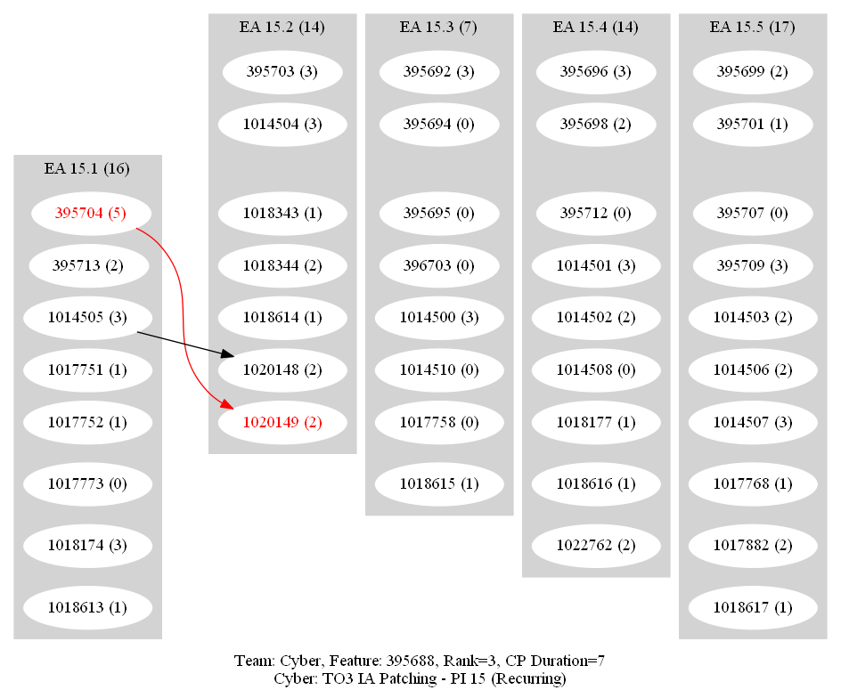
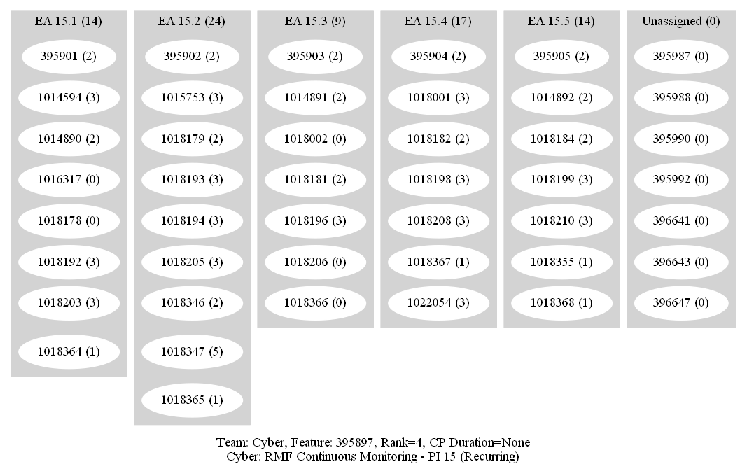
BACKUP
Auto-generated Dependency Graphs for PI 15 Features - Cyber

Slide 24
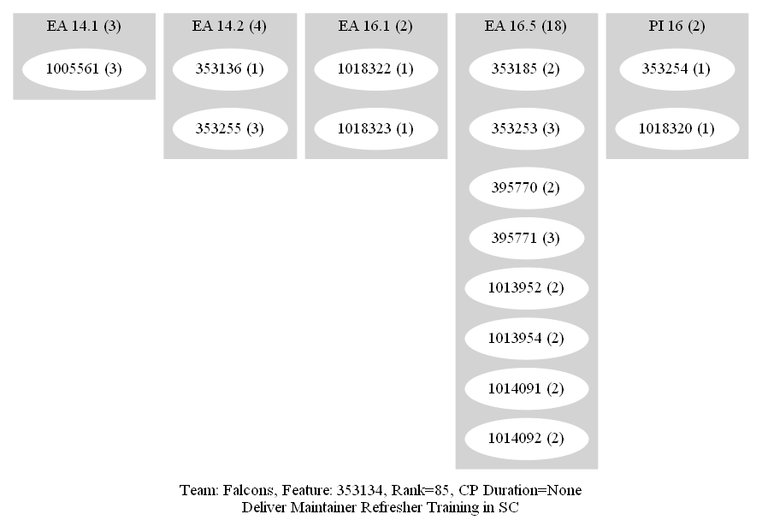
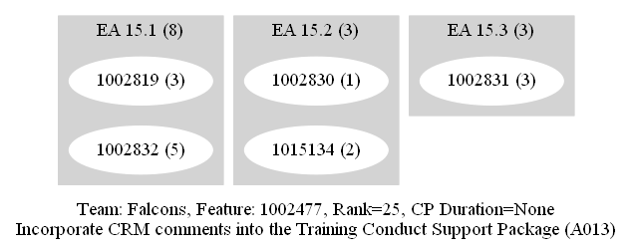
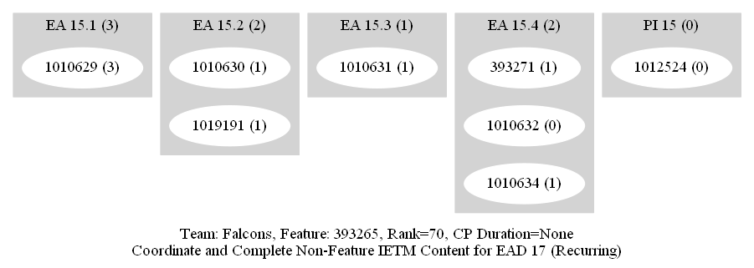
BACKUP
Auto-generated Dependency Graphs for PI 15 Features - Falcons

Slide 25
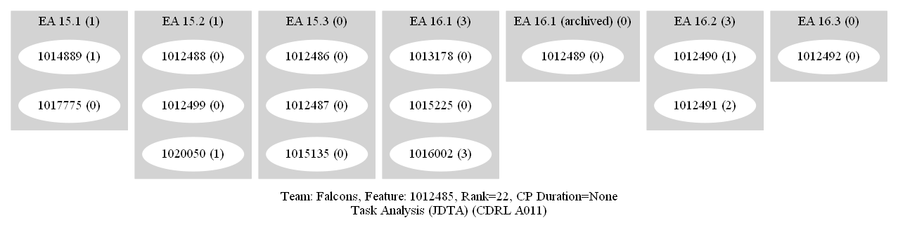
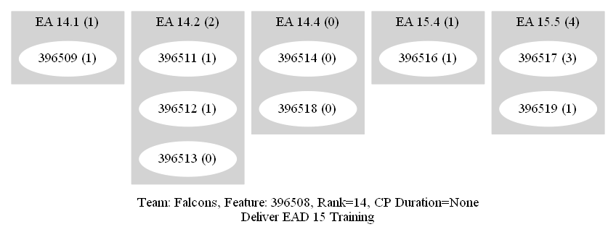
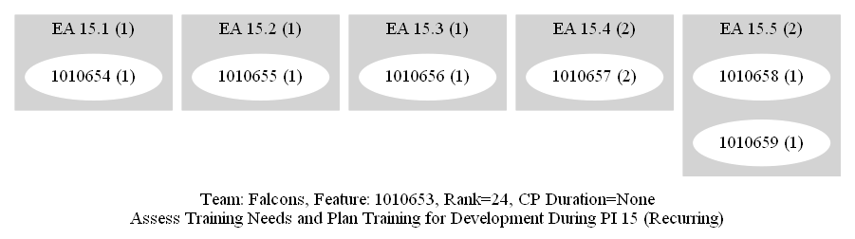
BACKUP
Auto-generated Dependency Graphs for PI 15 Features - Falcons

Slide 26
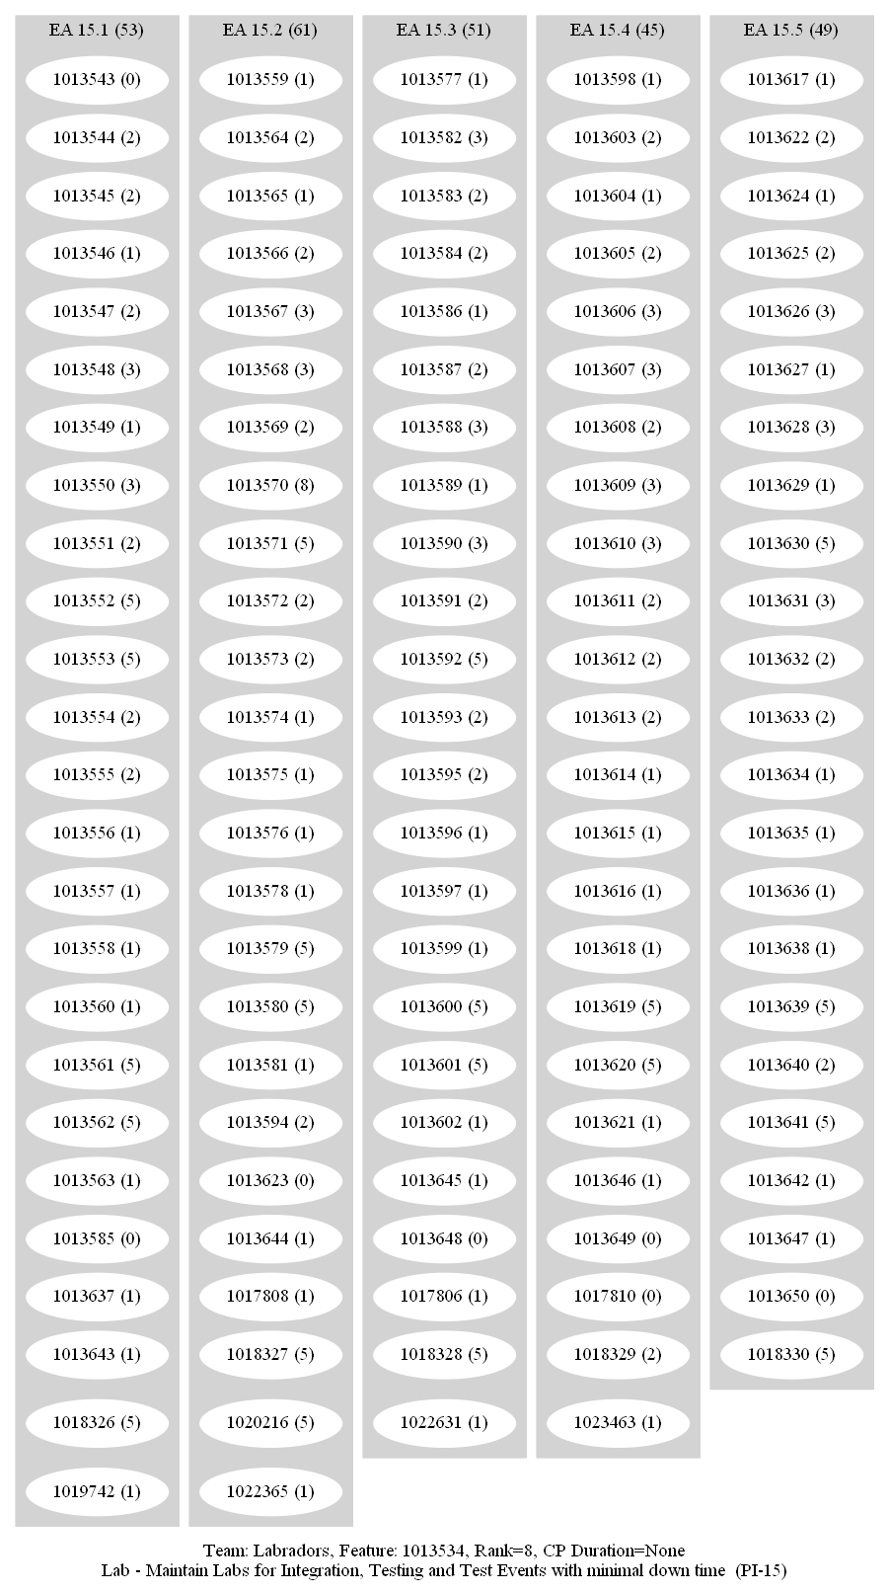
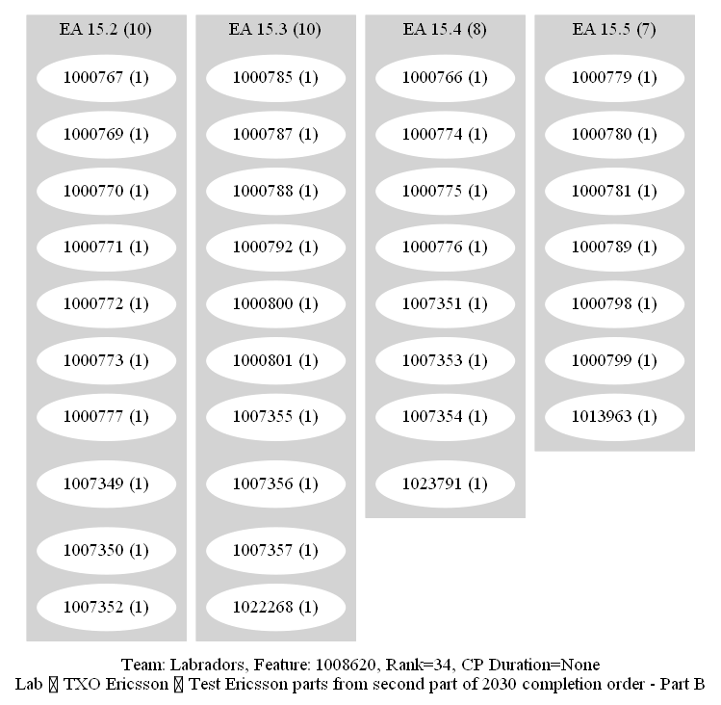
BACKUP
Auto-generated Dependency Graphs for PI 15 Features - Labradors

Slide 27
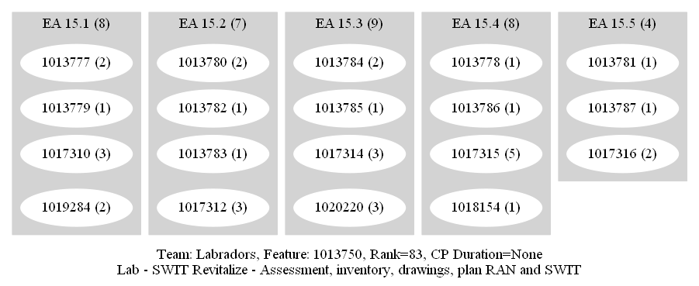
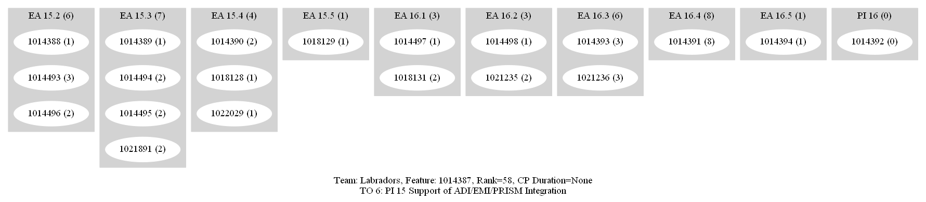
BACKUP
Auto-generated Dependency Graphs for PI 15 Features - Labradors

Slide 28
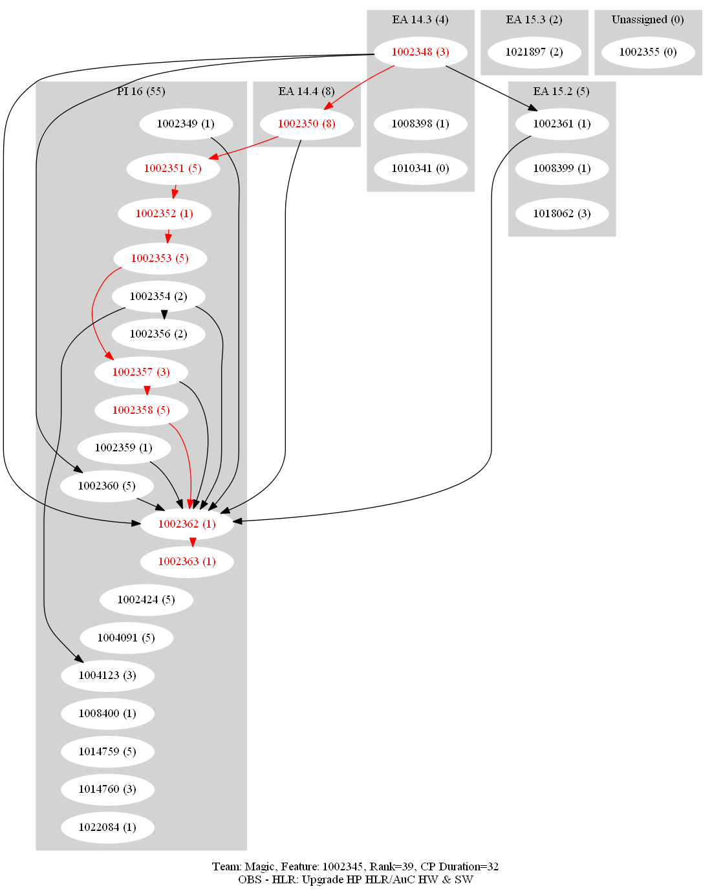
BACKUP
Auto-generated Dependency Graphs for PI 15 Features – Magic

Slide 29
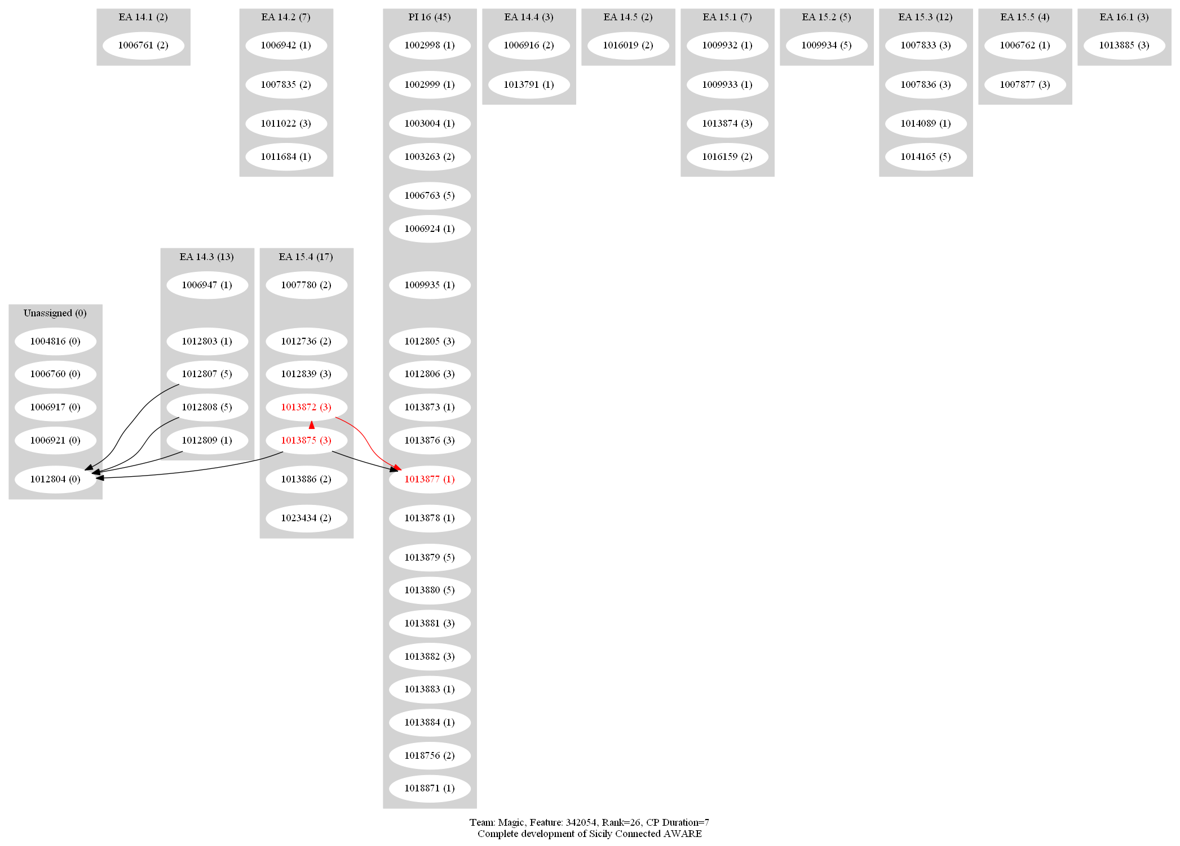
BACKUP
Auto-generated Dependency Graphs for PI 15 Features – Magic

Slide 30
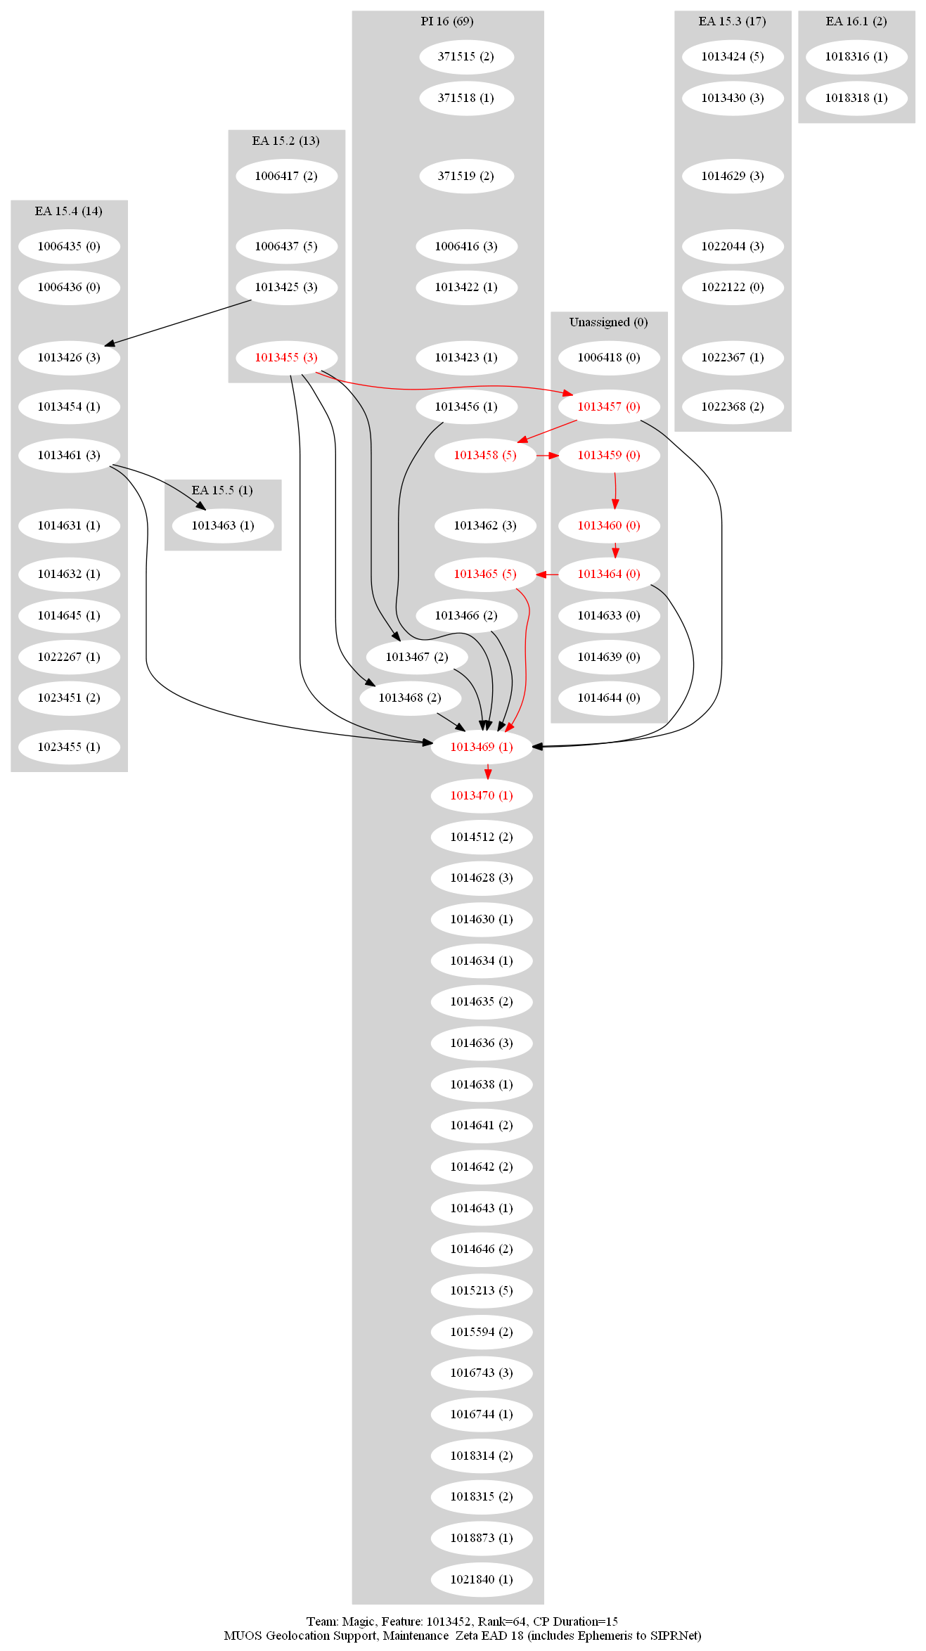
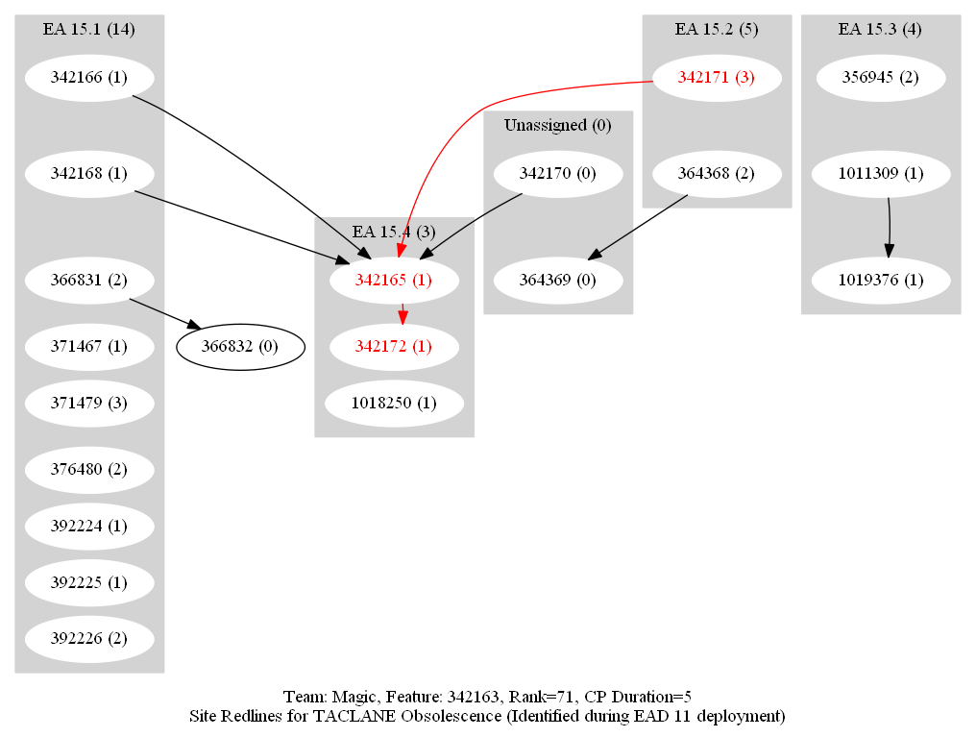
BACKUP
Auto-generated Dependency Graphs for PI 15 Features – Magic

Slide 31
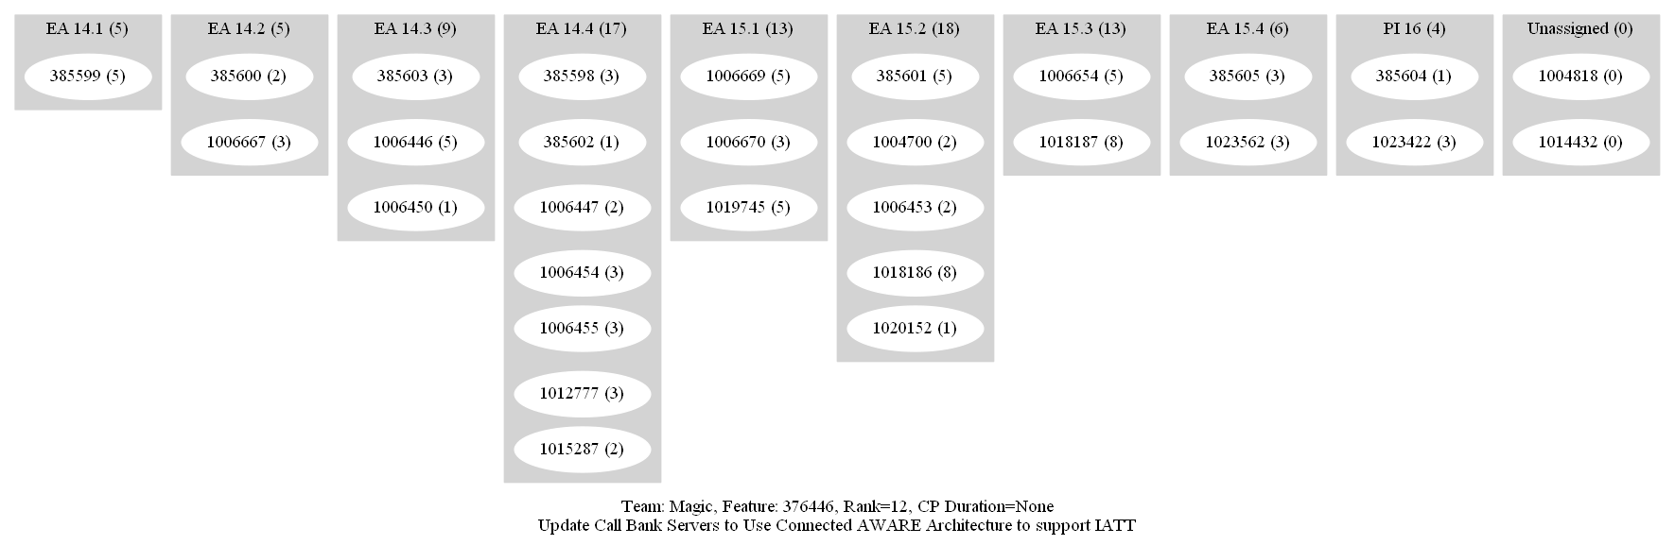
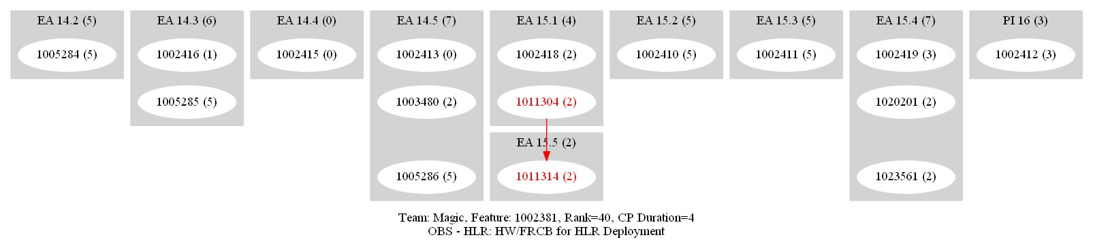
BACKUP
Auto-generated Dependency Graphs for PI 15 Features – Magic

Slide 32
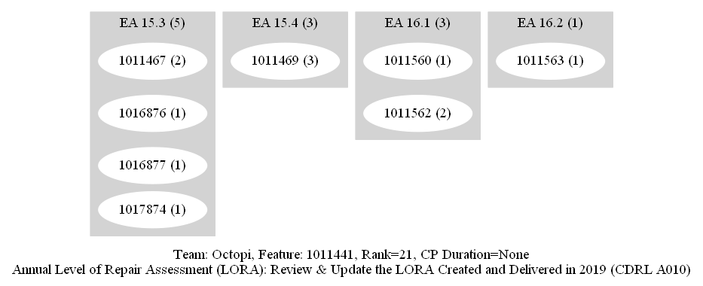
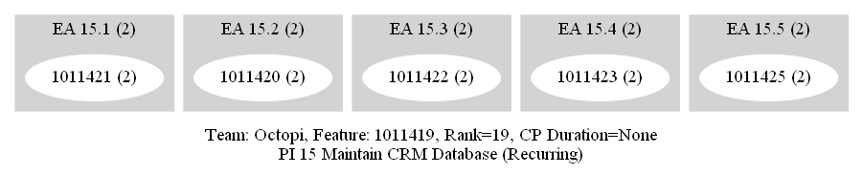
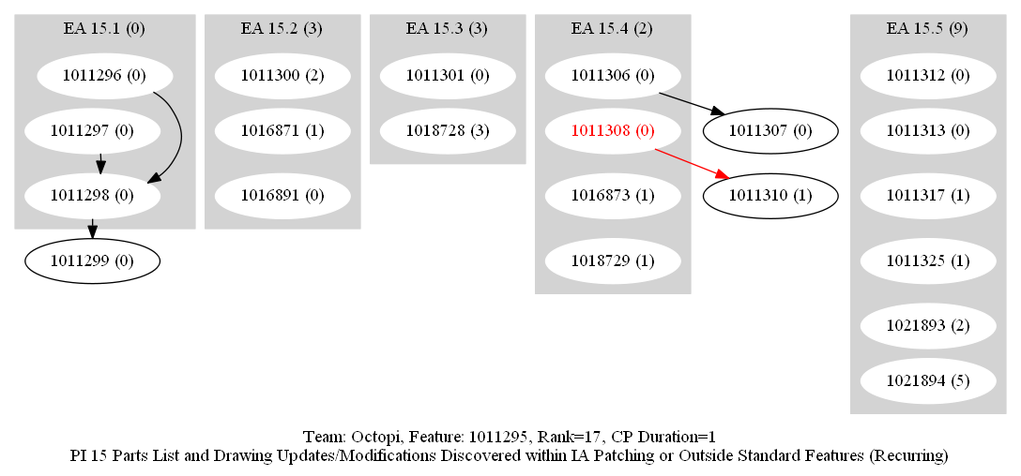
BACKUP
Auto-generated Dependency Graphs for PI 15 Features – Octopi

Slide 33
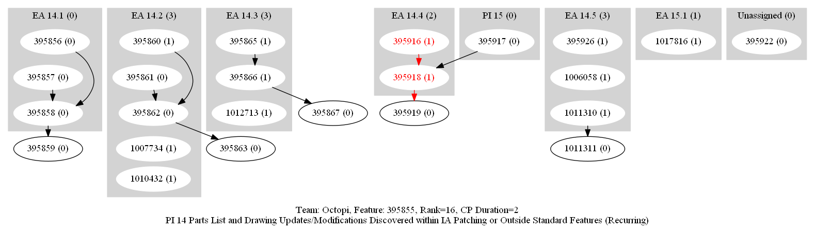
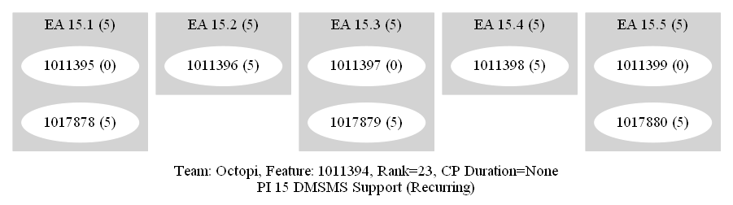
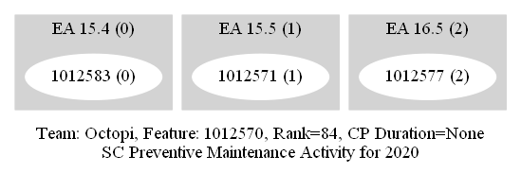

BACKUP
Auto-generated Dependency Graphs for PI 15 Features – Magic

Slide 34



BACKUP
Auto-generated Dependency Graphs for PI 15 Features – Magic

Slide 35


BACKUP
Auto-generated Dependency Graphs for PI 15 Features – Magic

Slide 36

BACKUP
Auto-generated Dependency Graphs for PI 15 Features – Okapi

Slide 37

BACKUP
Auto-generated Dependency Graphs for PI 15 Features – Okapi

Slide 38
BACKUP
Auto-generated Dependency Graphs for PI 15 Features – Okapi

Slide 39


BACKUP
Auto-generated Dependency Graphs for PI 15 Features – Okapi

Slide 40


BACKUP
Auto-generated Dependency Graphs for PI 15 Features – Okapi

Slide 41

BACKUP
Auto-generated Dependency Graphs for PI 15 Features – Roadrunners

Slide 42

BACKUP
Auto-generated Dependency Graphs for PI 15 Features – Systems

Slide 43

BACKUP
Auto-generated Dependency Graphs for PI 15 Features – Systems

Slide 44



BACKUP
Auto-generated Dependency Graphs for PI 15 Features – Systems

Slide 45


BACKUP
Auto-generated Dependency Graphs for PI 15 Features – Systems

Slide 46


BACKUP
Auto-generated Dependency Graphs for PI 15 Features – Systems

Slide 47

BACKUP
Auto-generated Dependency Graphs for PI 15 Features – SIC

Slide 48


BACKUP
Auto-generated Dependency Graphs for PI 15 Features – SIC

Slide 49

BACKUP
Auto-generated Dependency Graphs for PI 15 Features – SIC

Slide 50


BACKUP
Auto-generated Dependency Graphs for PI 15 Features – TOFF

Slide 51




BACKUP
Auto-generated Dependency Graphs for PI 15 Features – Tools

Slide 52


BACKUP
Auto-generated Dependency Graphs for PI 15 Features – Tools

Slide 53

BACKUP
Auto-generated Dependency Graphs for PI 15 Features – Tools

Slide 54


BACKUP
Auto-generated Dependency Graphs for PI 15 Features – WWTS

Slide 55

BACKUP
Auto-generated Dependency Graphs for PI 15 Features – WWTS

Slide 56

BACKUP
Auto-generated Dependency Graphs for PI 15 Features – WWTS

Slide 57


BACKUP
Auto-generated Dependency Graphs for PI 15 Features – WWTS

Slide 58

BACKUP
Auto-generated Dependency Graphs for PI 15 Features – WWTS

Slide 59

BACKUP
Auto-generated Dependency Graphs for PI 15 Features – WWTS

Slide 60
APPENDIX
Source Code for this project
Python 3 Script
Jinja2 Template

